Slide 1




First GOP Debate Twitter Sentiment
Data Collection, Processing, and Analysis

Slide 2



What is Sentimental Analysis?
Sentiment Analysis involves determining the sentiment expressed in a piece of text.
Used in various fields like marketing, customer service, and SOCIAL MEDIA monitoring.
Helps understand public opinion and improve decision-making.

Slide 3
Summary of Literature Review
Reviewed key studies on sentiment analysis techniques.
Common methods: Lexicon-based, Machine Learning, Hybrid approaches.
Identified gaps: Need for better handling of sarcasm, context-awareness.

Slide 4
Analytical Approach
Kaggle for Data Collection
TextBlob for Sentiment Analysis
WordCloud for Visualization
Emoji Handling in Sentiment Analysis
Latent Dirichlet Allocation (LDA) for Topic Modelling
Correlation matrix to examine relationships between themes and sentiments.

Slide 5


Results and Reports

Slide 6

1.Cleaned Files

Slide 7
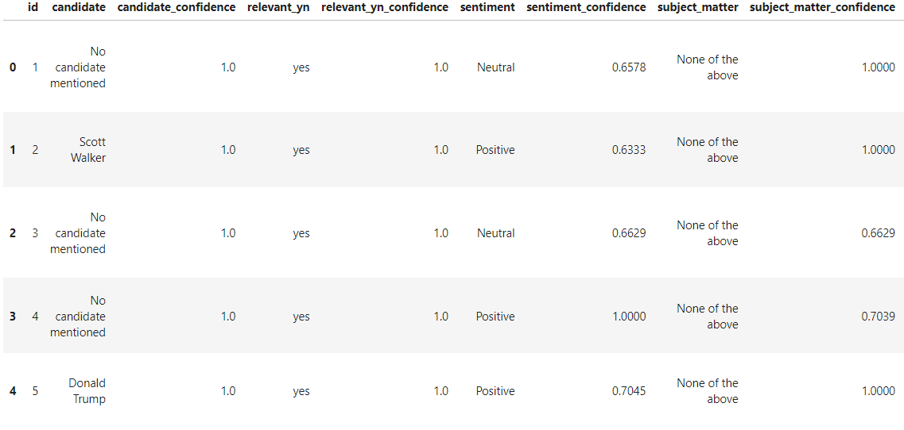
Sample of Analytical File

Slide 8
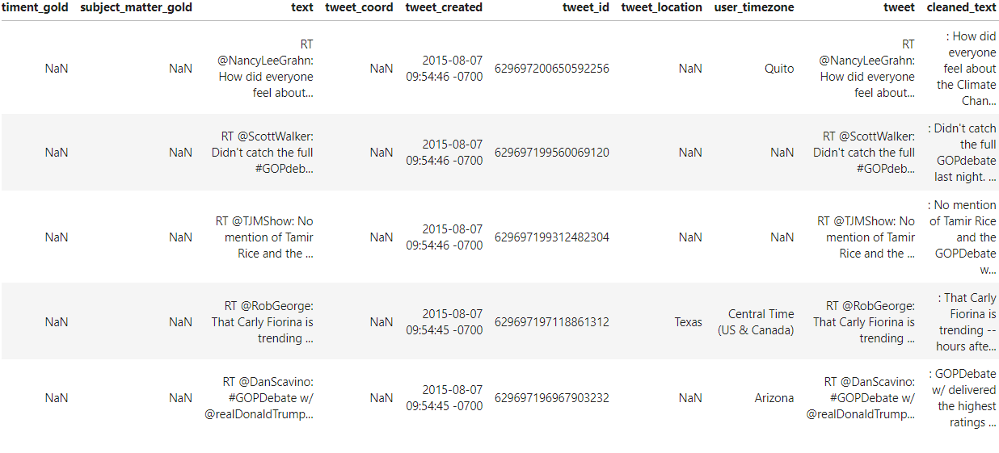
Sample of Analytical File

Slide 9

2. WordPress Analysis

Slide 10
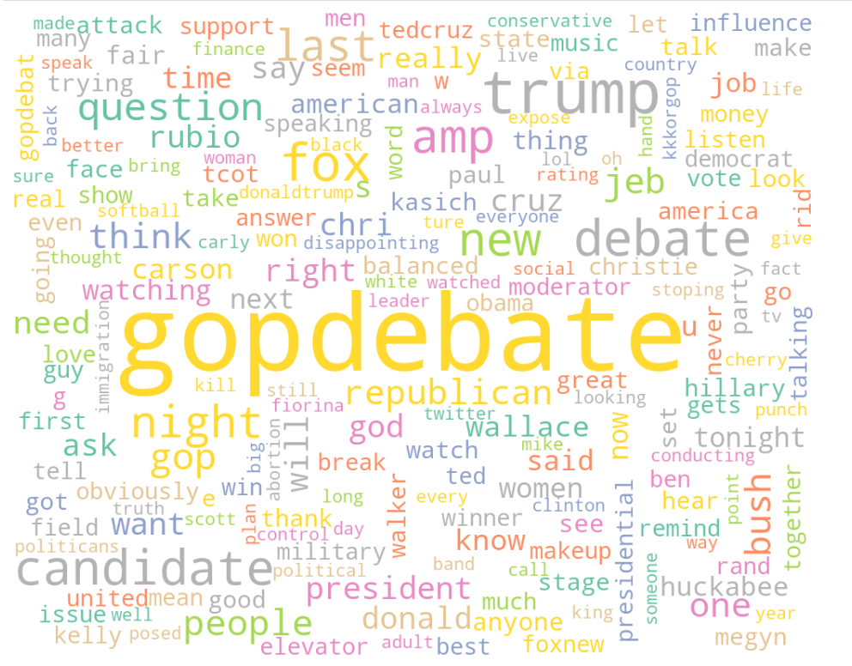
WordPress Visualization

Slide 11
WordPress Report
Key Takeaways:
Top 7 Words:
GOPDebate (7542 times)
Trump (1428 times)
Fox (997 times)
last (797 times)
News (679 times)
like (650 times)
GOP (542 times)

Slide 12
3. Sentimental Analysis

Slide 13
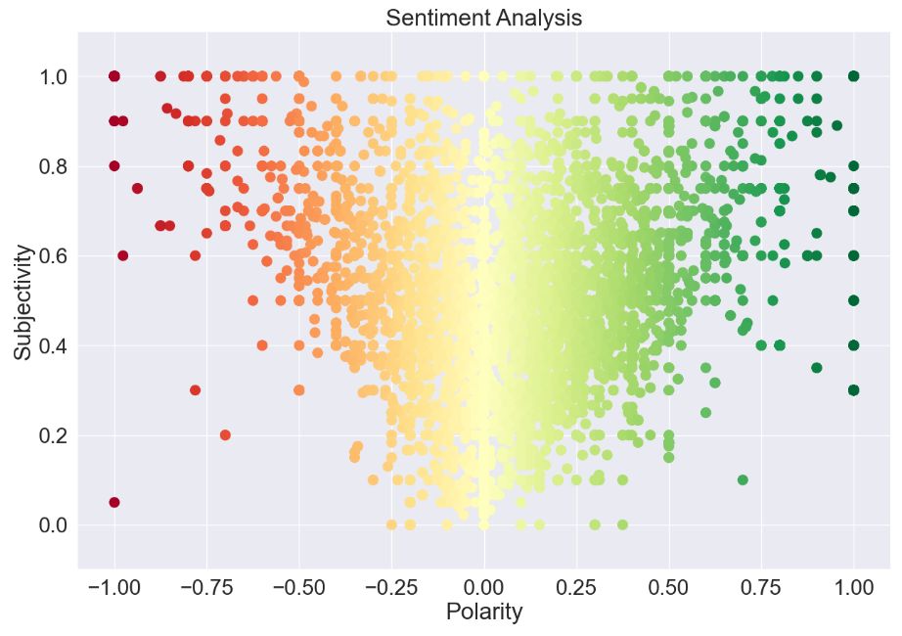
Sentiment Analysis

Slide 14
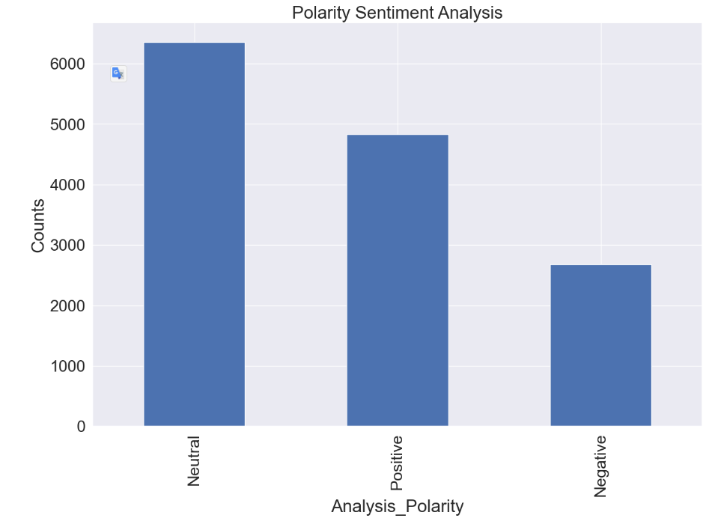
Polarity Sentiment Analysis

Slide 15
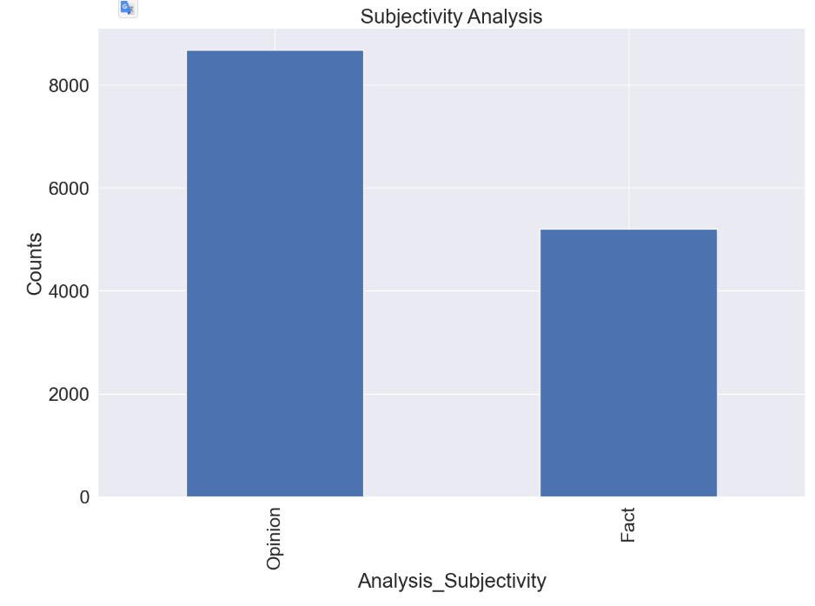
Subjectivity Sentiment Analysis

Slide 16
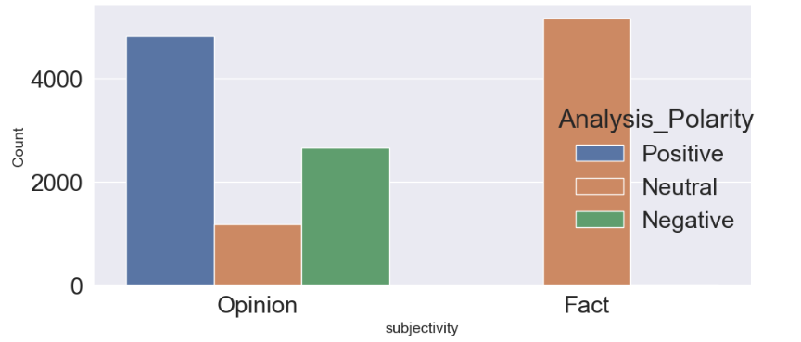
Grouped Subjectivity Sentiment Analysis

Slide 17
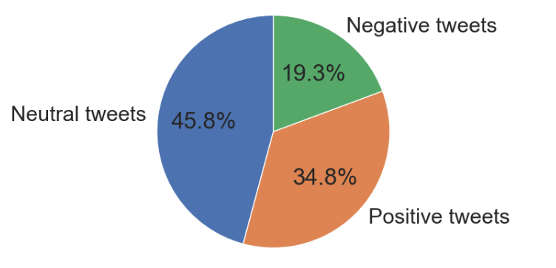
Grouped Subjectivity Sentiment Analysis

Slide 18

4. Topic Theme Analysis

Slide 19
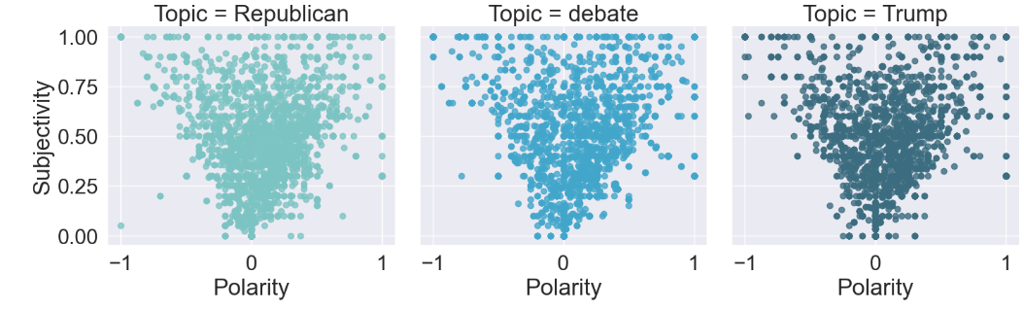
Polarity Subjectivity Sentiment Analysis by Themes

Slide 20
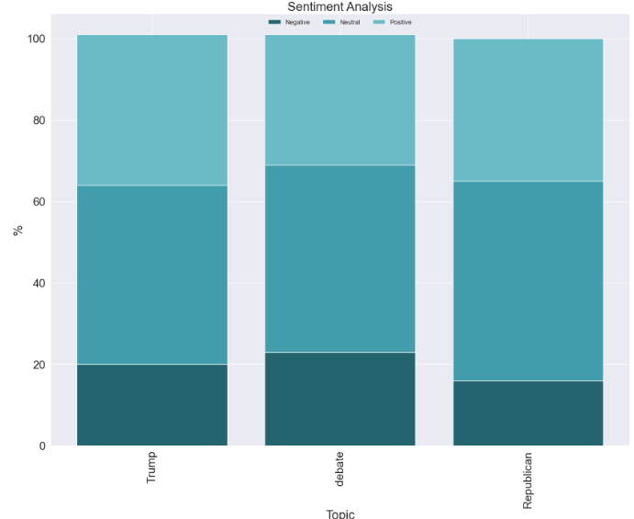
Sentiment Analysis by themes

Slide 21
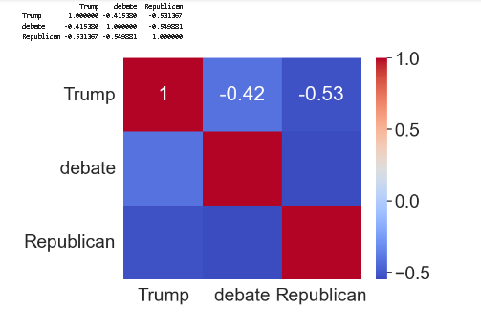
Correlation between themes

Slide 22
Conclusion/Findings
Unify Messaging: Address the disconnect between Trump and broader Republican themes by aligning his messaging with the party's values.
Engage Neutral Audiences: Focus on converting the large neutral sentiment (45.8%) into positive support by emphasizing clear, relatable arguments.
Reduce Negative Sentiment: Tackle the 19.3% negative sentiment by addressing specific concerns raised in tweets to improve public perception.

Slide 23

Thank you!

